Slide 1
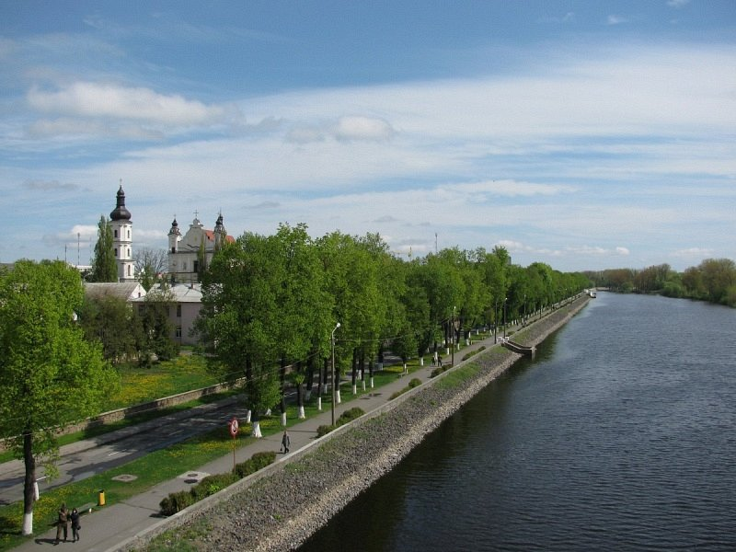
Pinsk

Slide 2
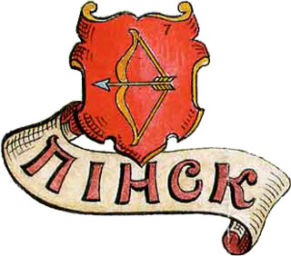
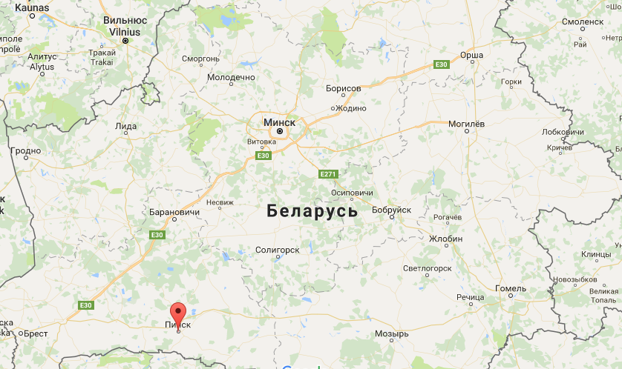
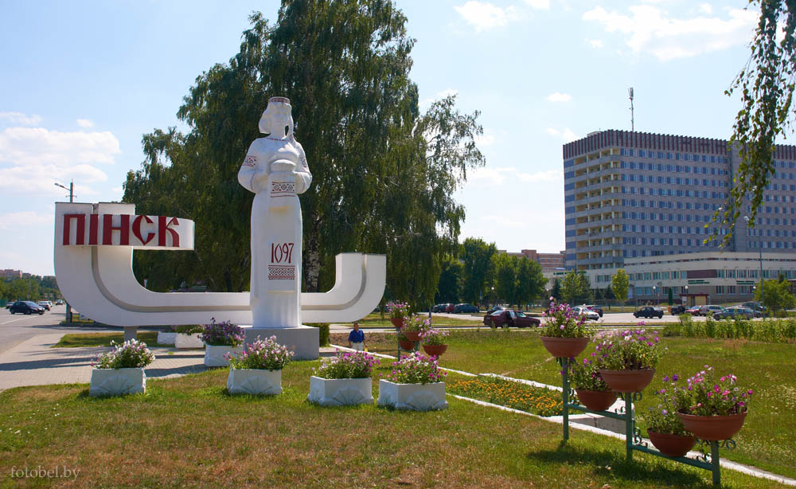
Pinsk is located in the Brest region
The population is near 140 thousand people
The area of Pinsk - 50 thousand square km
It is one of the historical and cultural centers of Polessye (“Pinsk - the capital of Polessye”)

Slide 3
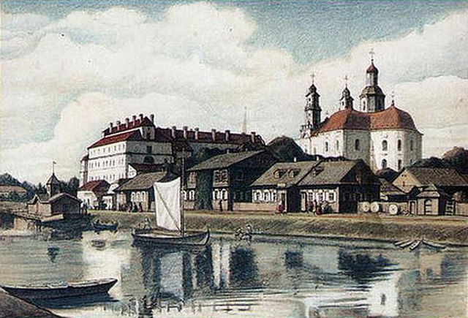
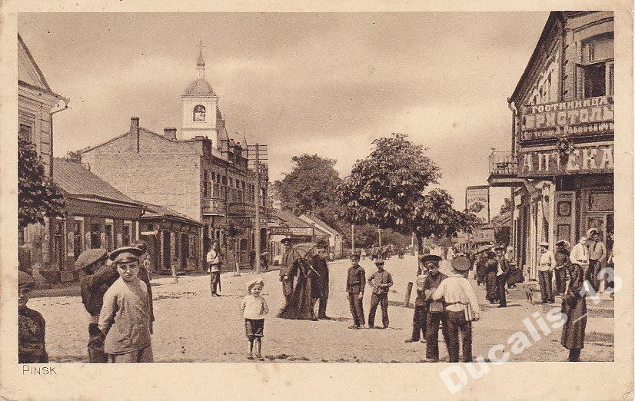
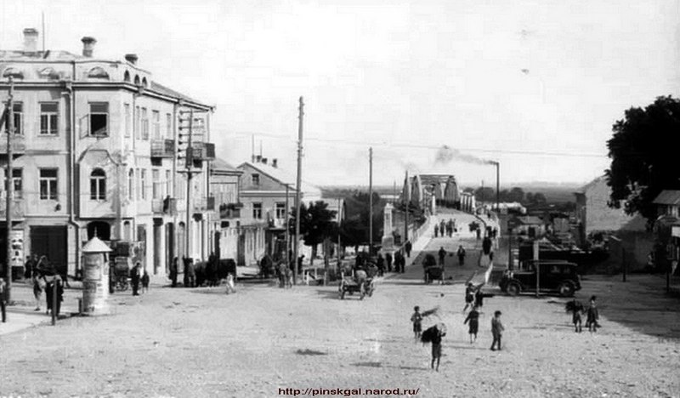
Pinsk in 1920-1940 years.

Slide 4
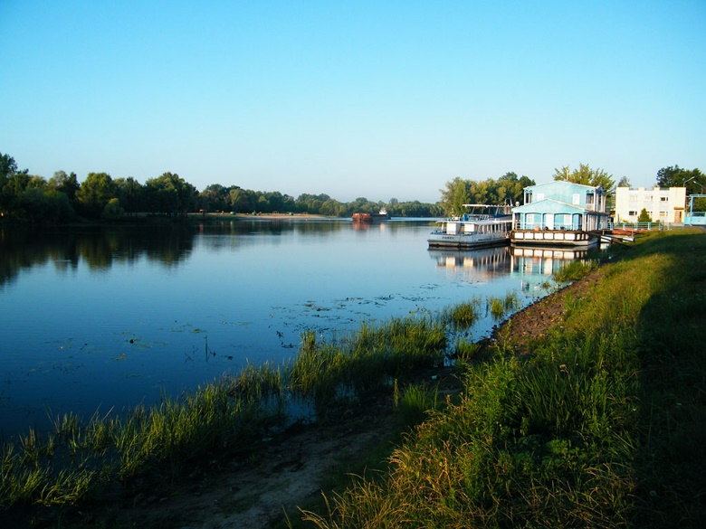
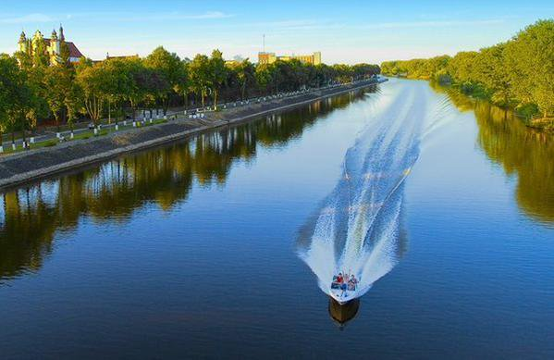
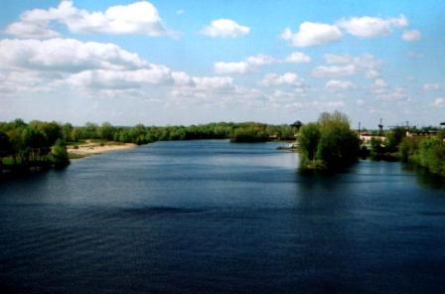
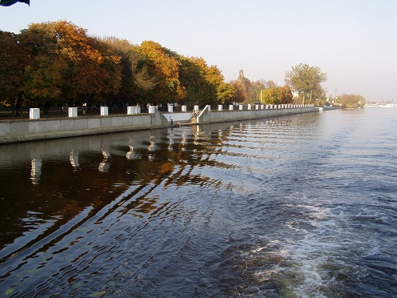
First time Pinsk was mentioned in the chronicles of 1097 as Pinesk.
The name is derived from the river Pina, those you can see on the pictures.

Slide 5
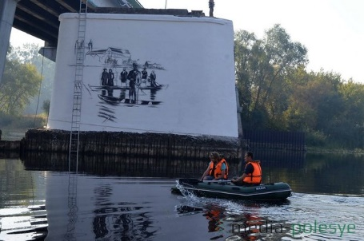
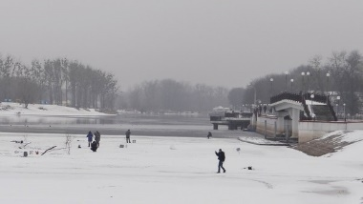
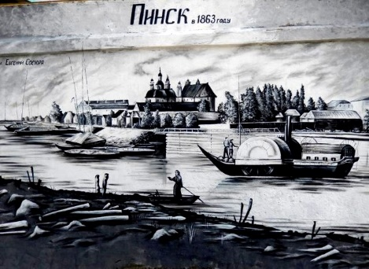
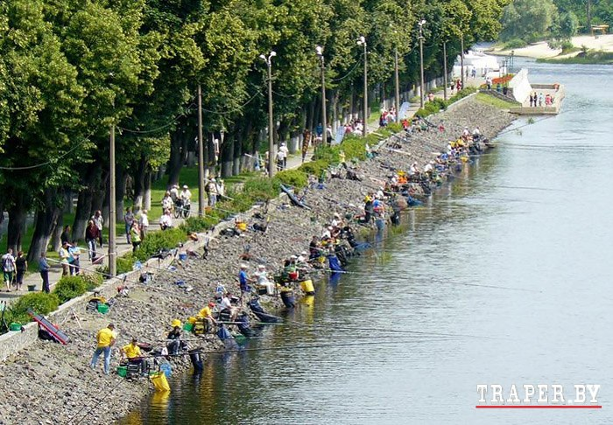

Relief of the territory, which is located in Pinsk, flat, slightly descending to the flood plain Pina. In the historic center of the city, near the city park, Pina flows into the Pripyat. On the territory Pinsk river does not have any inflows.
June 15-16 2013, 2013, held the 1st stage of the open championship of Belarus in sport-fishing rod in summer

Slide 6
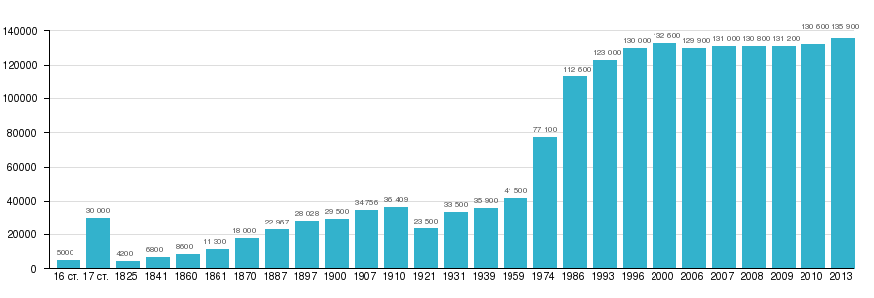
Pinsk ranked 10th most populous in the country, in the Brest region - 3
Pinsk - a cosmopolitan city. According to the 1999 census, in Pinsk lived more than 85% of Belarusians, about 9% Russian, about 3.5% of Ukrainians, Poles about 1%, about 0.15% of the Jews
Changing the number of population (XVI-XXI century)

Slide 7
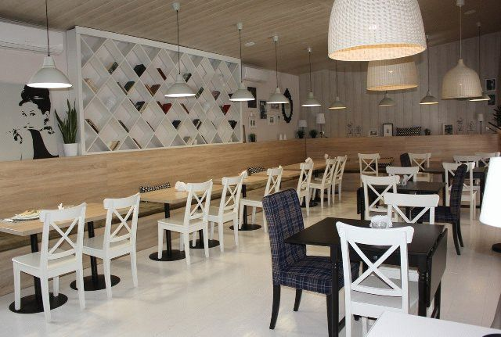
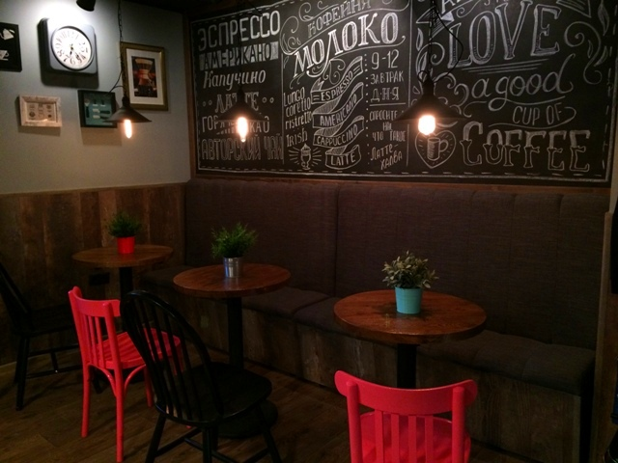
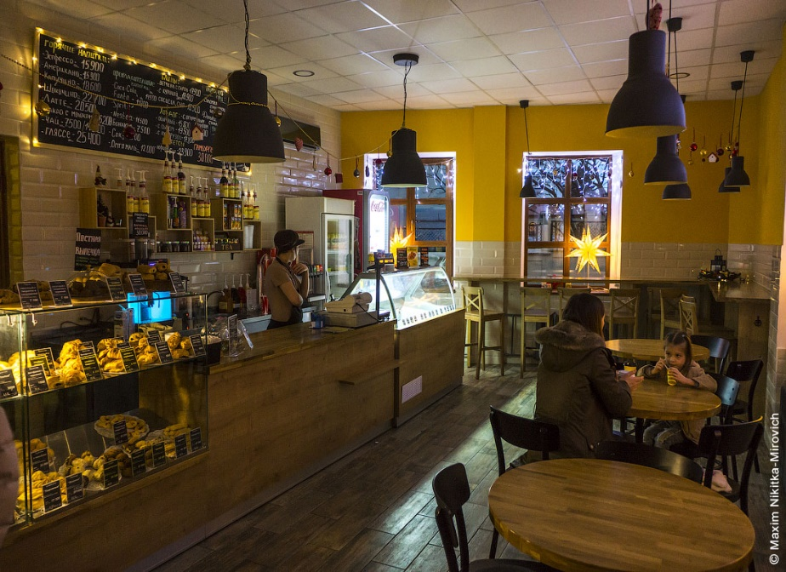
Our sights
In Pinsk you can visit charming places and have quiet cup of coffee or tea with your friends.
Cafe "Bona Sforca"
Coffee-house "Moloko"
Bakery "Zalaty Kolas"

Slide 8
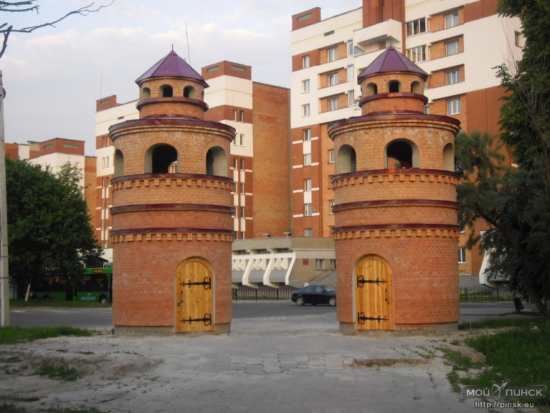
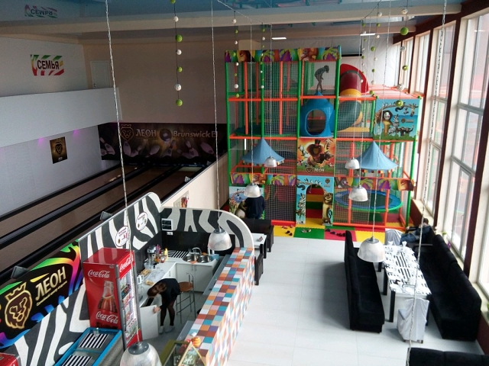
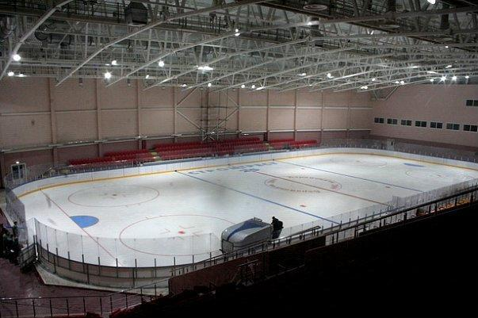
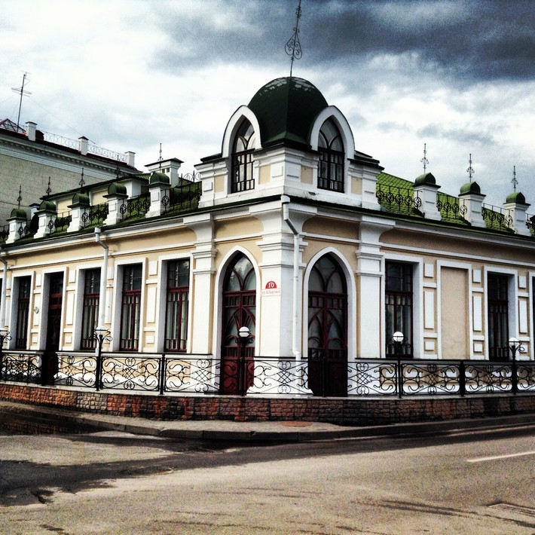
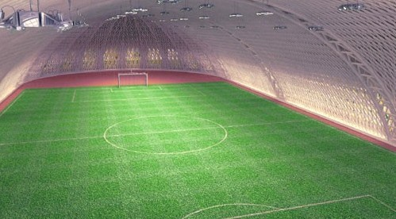
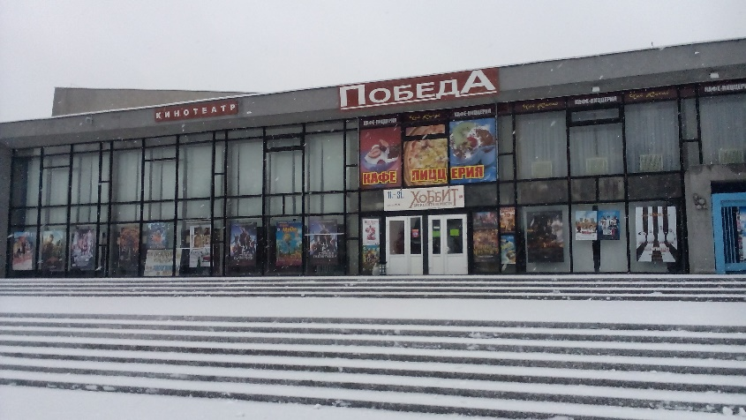
In Pinsk you can visit swimming pool, bowling, pool, ice arena, football manege, theater, cinema, several parks, various restaurants and casino.

Slide 9
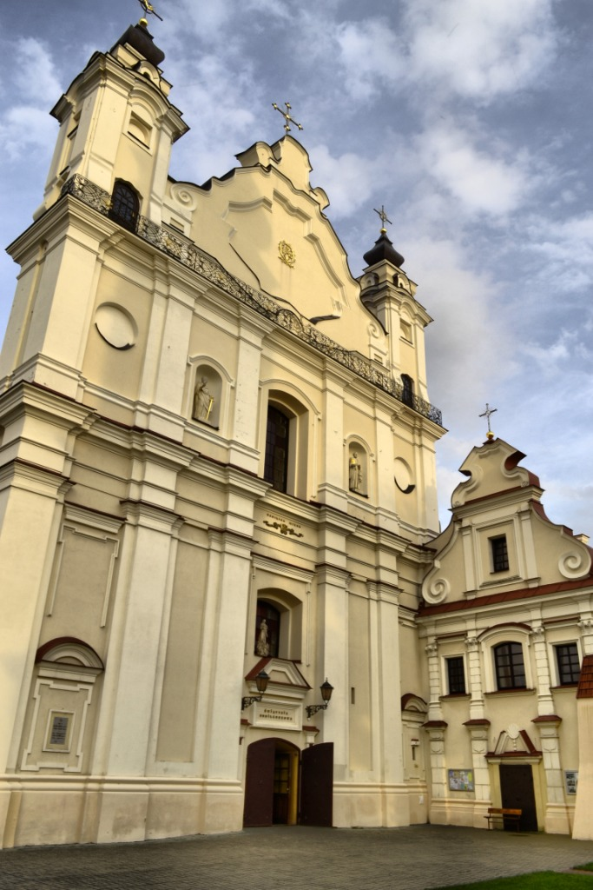
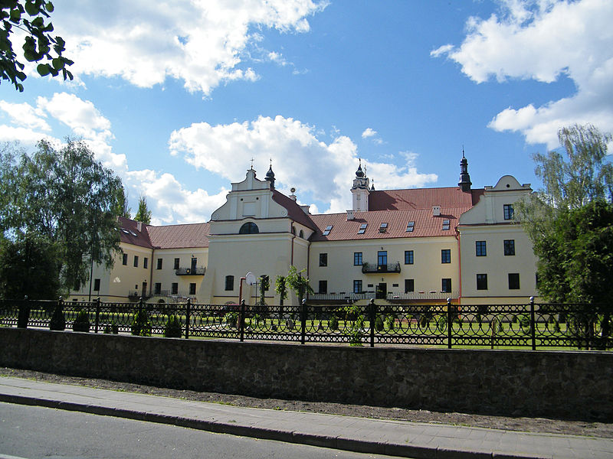
The main sights of the town are lined along the river.
Cathedral of Name of the Blessed Virgin Mary (former Monastery of the Franciscans)

Slide 10
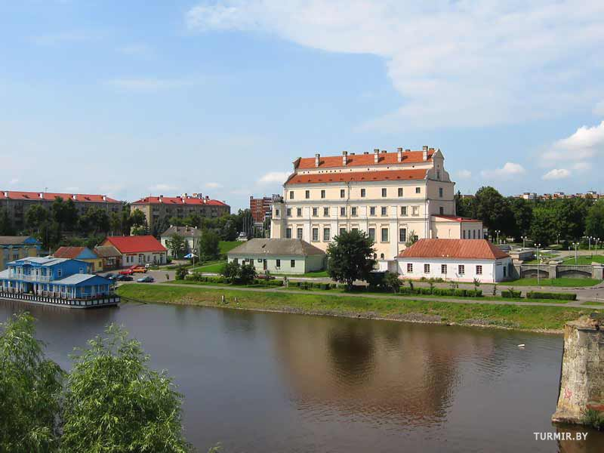
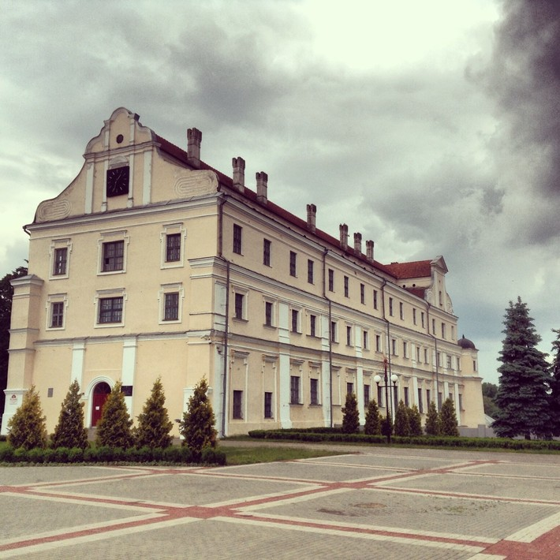
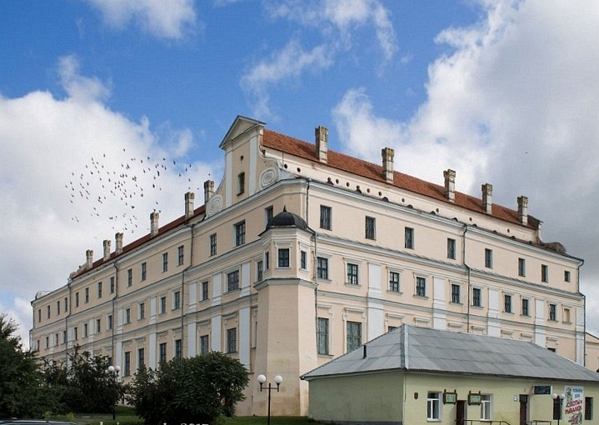
Jesuit collegium
Beautiful view from Lenin Square
View from the bridge, on the side of the river

Slide 11
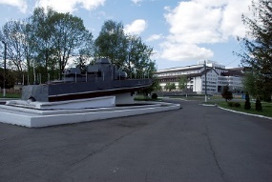
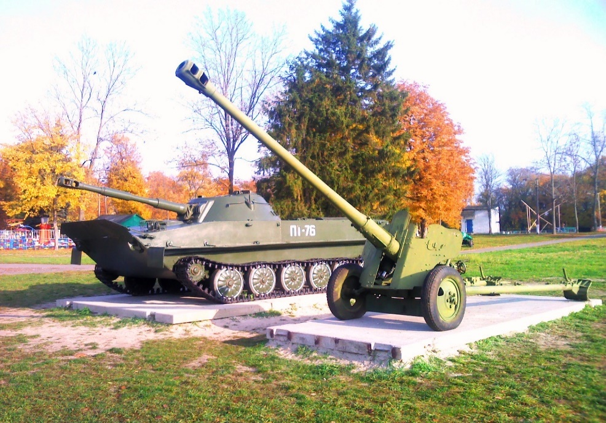
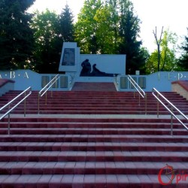
The Dnieper Flotilla Park.
It was founded in 1858 as a city park near Leszczyński Monastery (not preserved any more). There is a memorial at the site of the ancient monastery, "Memorial Complex to the Liberators", a gun-trophy of 1812, an artillery gun from World War II, a monument to soldiers- internationalists, former pavilions of "Polesie Fair" (1930) on the territory of the park.

Slide 12
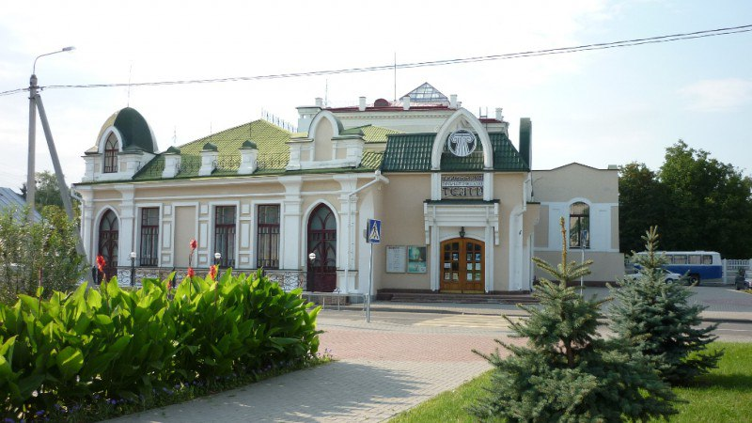
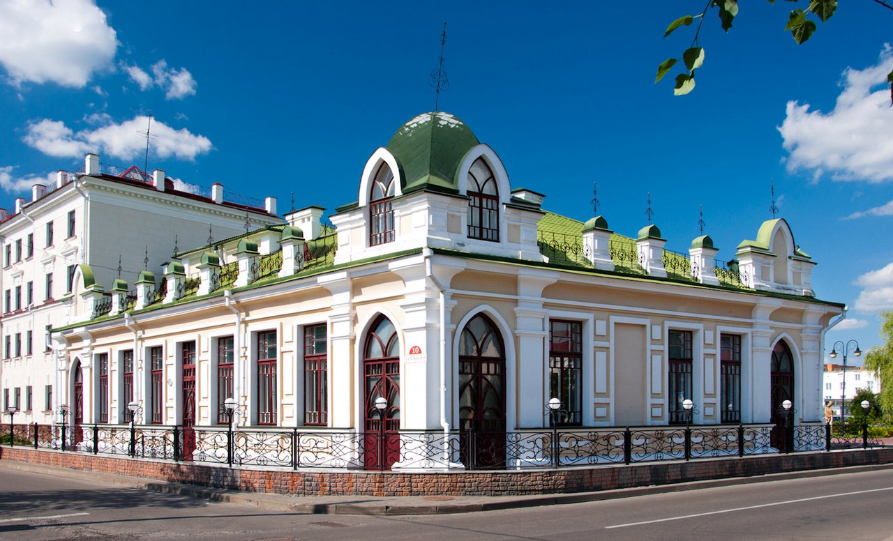
Polessye drama theatre
Opened in 2005 in the reconstructed building of the first Pinsk cinema "Casino" (1911-1912), built in the art Nouveau style.

Slide 13
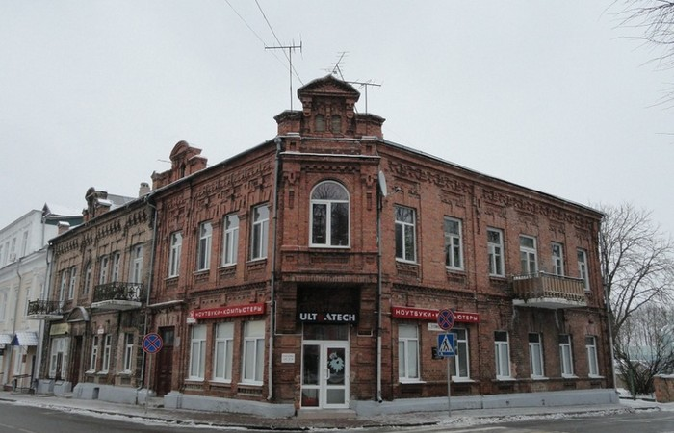
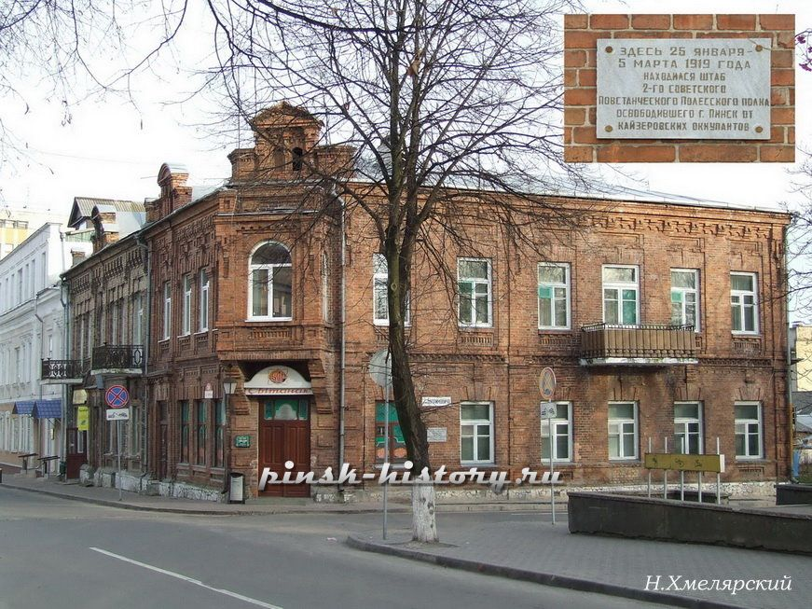
House of the Orda
House of the Orda (Lenin Street) was constructed at the beginning of the XX century in the eclectic style for Leontyne Orda from a well-known Polessye family. The cut off corner of this building is allocated with a bay window and a kokoshnik board, facades are trimmed by an ornamental laying. In 1919 the staff of the Polessye communistic insurgent regiment was placed there. During the Polish period it was the library of the Orda.

Slide 14
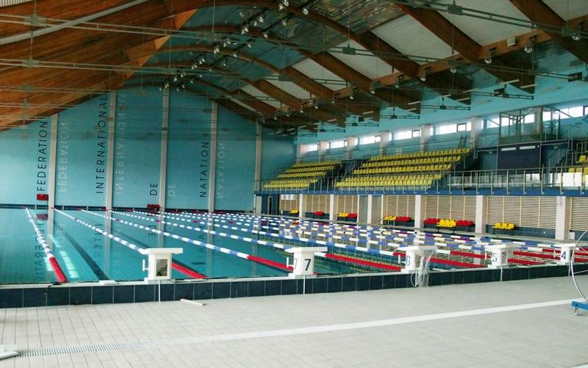
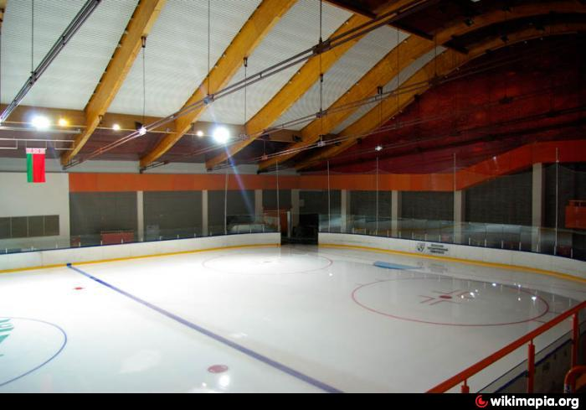
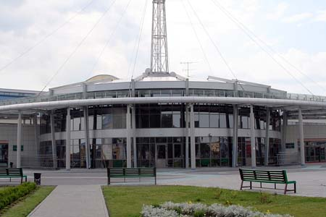
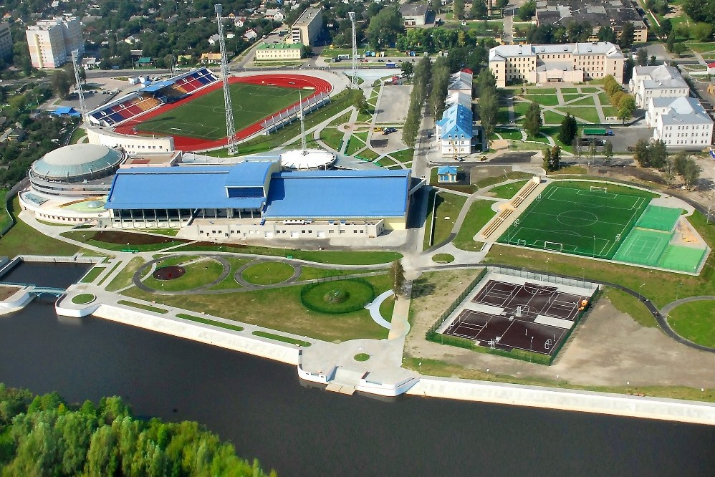
The Sporting Complex «The Wave»
The Sporting Complex «The Wave». Newly founded young Polessye State University is proud of its universal sporting complex (2006). It is situated on the riverside on border of Lestcha and Albrehtovo. There is a stadium with a soccer field, racecourses, tennis courts, playgrounds, the Ice palace (2008), the swimming pool (2008).

Slide 15

Education in Pinsk
19 schools (3 gymnasiums);
7 specialized secondary educational establishments;
1 university (Polesski State University).

Slide 16
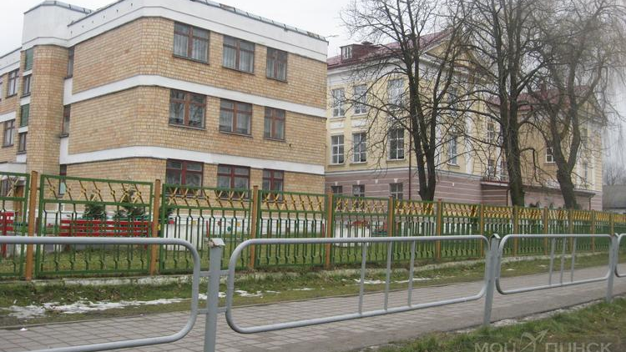
Our school
Gymnasium #1

Slide 17

Factories in Pinsk

Slide 18
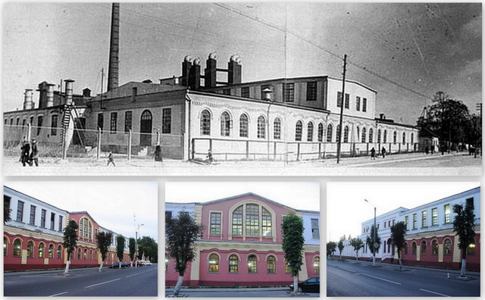
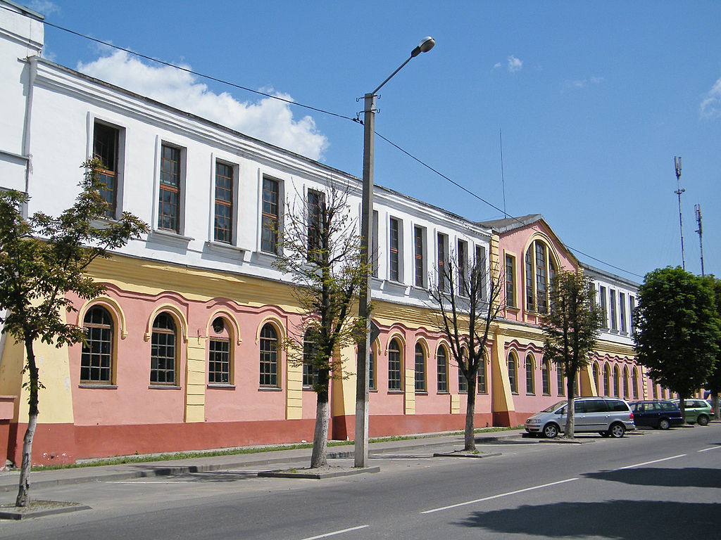
Match and wood-working factory Pinskdrev
Match factory (Brestskaya Street) is one of the oldest enterprises of Pinsk (1882). It can obviously be considered the museum-enterprise. The architecture of factory building is very interesting. It is a sample of an industrial construction of the end of the XIX – the beginning of the XX centuries.

Slide 19
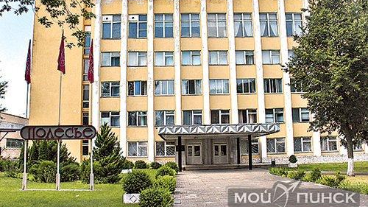

Knitted factory "Polesye"

Slide 20
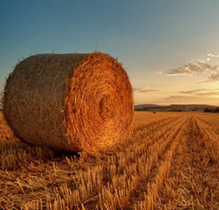
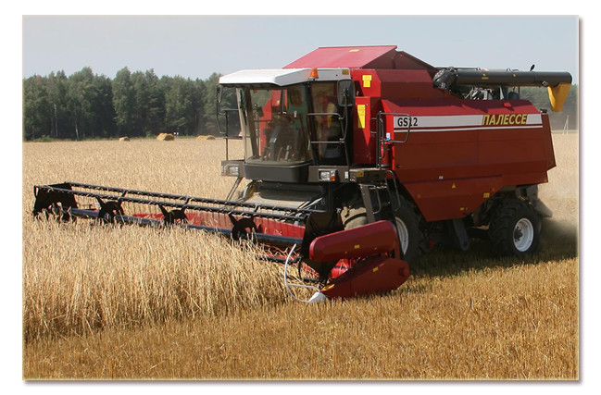
Agriculture
Agriculture specializes in meat and dairy farming, the production of grain and sugar beets, forage crops, potatoes, flax, vegetables. Food processing industry (pastries, jelly, wine and liquors products, wine and soft drinks, starch), metal-working, cooperative, garment industry, forestry (lumber, wood), production and trade company "Medtech"

Slide 21

Sports
We have professional football team "The Wave" and professional motoball team. Also there are youth sports school where children are tought such sports as tennis, chess, swimming, basketball and valeyball.

Slide 22
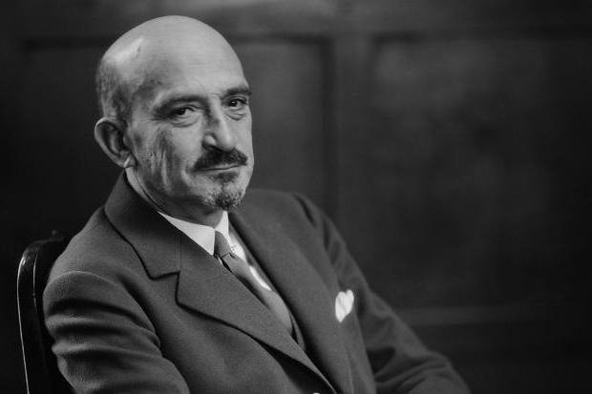
Famous people
The First President of Israel
The first president of Israel, Chaim Weizmann was born near Pinsk, in the village of Motol, where he graduated from the header. Once enrolled in Pinsk Realschule, after which he continued his education in Germany and began his journey to the formation of the State of Israel.

Slide 23
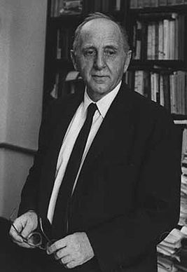
Simon Smith Kuznets
Simon Smith Kuznets - American economist, statistician, demographer and historian of the economy. Laureate in Economics 1971 Nobel Prize. The name Kuznets associated formation of economics as an empirical scientific discipline and the development of quantitative economic history.

Slide 24
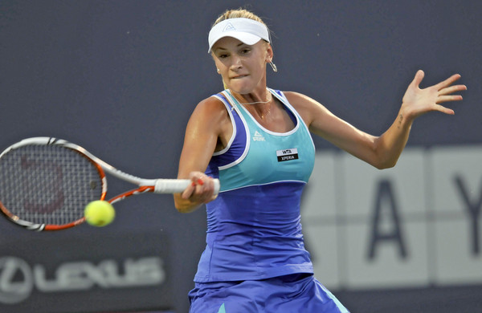
Olha Govortsova
Olha Govortsova - professional tennis player, was born in Pinsk. Highest position in world singles ranking - 35(2008), in doubles – 24(2011). 8 tituls in doubles, winner of junior Wimbledon in doubles (2004).

Slide 25

Evgeniy Gvozdev
Evgeniy Gvozdev – Russian seafarer and traveler, was born in Pinsk in 1934. He made 3 around-the-world cruises and always returned from them safe and sound.

Slide 26
THANK YOU FOR WATCHING!

